Slide 1
Project I
TA: Jun-Bin Zhang, Sheng-Hui Peng, An-Fong Li
Office Hour: 15:00 - 18:00 Monday
13:00 - 18:00 Wednesday
At 95521 CPS Lab or LINE or Email
p78083025@ncku.edu.tw
2021.05.05

Slide 2
Notice
Programming language : Python 3 (https://www.python.org/downloads/)
socket
JSON
Threading
Due date => 5/19

Slide 3
Project 1
1.1 Network topology construction
1.2 Socket implementation

Slide 4
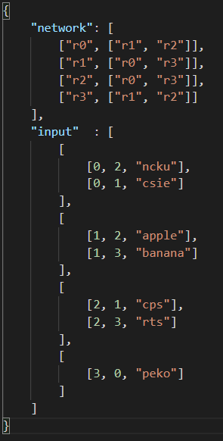
1.1 Network topology construction
Given an network topology and input with a JSON format
Input : input.json, open file to read the data
Network topology input format :
[“source”, [“destination1”, “destination2”…]]
Data Packet input format:
[source(routerID), destination(routerID), data]
r1
r0
r3
r2

Slide 5
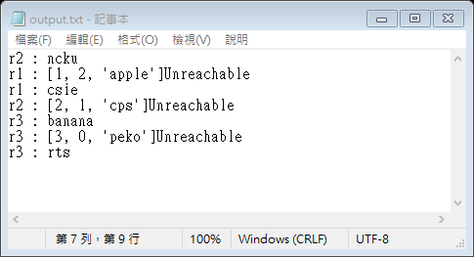
1.2 Socket implementation
Implement sockets for data transmission
Output : output.txt, write you result to “output.txt” file
Output format :
“destination” : data
“destination” : packet Unreachable
…
Demo needed

